Slide 1
Basic Commands of using nmap tool on kali Linux
This PowerPoint Slides will be talking about the basic commands you will be using when you implement nmap tool in Kali Linux. Please make sure to understand and each command will contain some explanation as what it outputs on the screen. Remember, nmap tool app is also available for windows and other operating system such as Mac.

Slide 2
Definition of nmap tool?
Nmap is a tool is used to scan a specific network or a host. It usually reports back a list of results such as open, filtered, unfiltered, open filtered, closed, closed-filtered.
It simply scans the network, target, and returns back information that can be used in other tools such as Meta exploit tool for further discovery. It is extremely useful for identifying vulnerabilities.
The most efficient OS used for penetration testing is Kali Linux and it still ranks among the first options, if not the first, for testing a network for vulnerability.
The remaining parts of this Tutorial requires you to have Kali Linux installed or used on either virtual box or VMware.

Slide 3
First Command is simple. Nmap network/prefix
For example, suppose I am currently connected to a network 192.168.0.0/24, to issue the nmap command to scan it, we can use:
nmap 192.168.0.0/24
It will make you wait for sometime to gather all the information possible, and usually, it focuses on the most used 1000 ports.

Slide 4
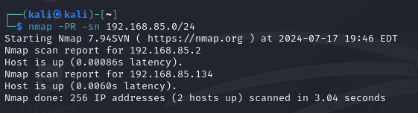
Second Command(Layer 2 Scan) nmap –Pr –sn NETWORK/PREFIX
Nmap here is scanning the network at layer 2, Data-link Layer, and must keep in mind that letters are case-sensitive and must always write your commands according to their standards.
In this process, the nmap sends a broadcast to the devices on the network to limit the targets of hosts up and running in the network. Then, we can copy the hosts up to a list and perform another scan on them using the list created…
An example:

Slide 5

How to Create a list of IPs to use:
To create a list of IPs, we can simply run the command nmap 192.168.0.0/24 for example and as a result, we will get back the hosts that are up and running. We can simply open a text file from the CMD window issuing the command:
nano iplist.txt
And add the IPs inside as it appears in the following diagram:

Slide 6
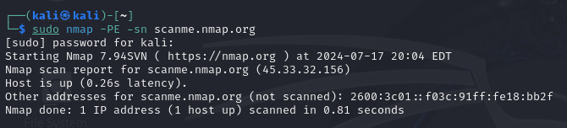
Third Command(Layer 3 Scan): nmap –PE –sn URL
nmap provides a website for this purpose, we can issue this command to test the layer 3. scanme.nmap.org is a website we can use as it appears in the following diagram:
The command simply sends ICMP request to make sure there is an action on layer 3 and we got the results back. We know now the IP address, which is 45.33.32.156. There is a big chance you might be denied because of the target website is implementing a firewall that prevents such requests. And in this case, we will be using an alternative method, which is what we will be discussing below.
.

Slide 7
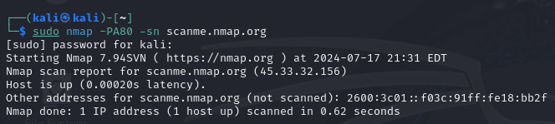
Fourth Command(Layer 4) Transport Layer: sudo nmap –PA80 –sn URL
To test the transport layer, we can issue the following command as it appears in the diagram below:
The process is sending acknowledgement to the host and it responded with TCP/IP packet indicating that we have received the packet and there is no open communication channel, and that means the host is up.

Slide 8
NMAP – PORT states:
We have six types of port states in nmap:
Open: an open port is one that is actively accepting TCP, UDP, or SCTP connections. Open ports are what interests us the most because they are the ones that are vulnerable to attacks. Open ports also show the available services on a network.
Closed: a port that receives and responds to nmap probe packets but there is no application listening on that port. Useful for identifying that the host exists and for OS detection.
Filtered: nmap can’t determine whether the port is open because packet filtering prevents its probes from reaching the port. Filtering could come from firewalls or router rules. Often little information is given from filtered ports during scans as the filters can drop the probes without responding or respond with useless error messages such as destination unreachable.
Unfiltered: Port is accessible, but nmap doesn’t know if it’s open or closed. Only used in ACK scan which is used to map firewall rulesets. Other scan types can be used to identify whether the port is open.
Open/Filtered: nmap is unable to determine between open and filtered. This happens when an open port give no response. No response could mean that the probe was dropped by a packet filter, or any response is blocked.
Closed/Filtered: nmap is unable to determine whether port is closed or filtered.

Slide 9
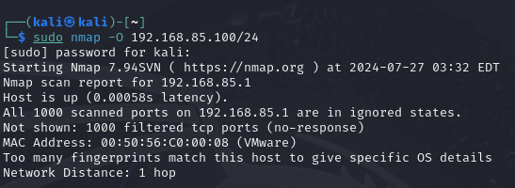
Checking Operating System: nmap –O NETWORK/PREFIX
To check the operating System, we can issue the following command and it should be preceded with sudo command as it appears in the picture below:
It will scan the network and return the OS of the up and running hosts. It is a straight-forward example.

Slide 10
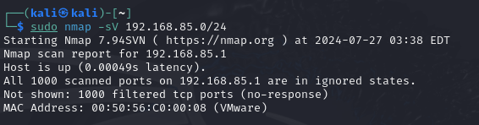
Checking Version: nmap –sV NETWORK/PREFIX
To check the version of a scanned network, which means every single host up and running will send back its version, we can simply issue a command similar to this one below:
It should return back the version, there are times when it simply cannot do that, but among the commands we can issue to discover the hosts is the - sV
The Command is a straight-forward command and please remember the sudo privilege because it wouldn’t work with normal user privileges, it always requires sudo privilege to run.

Slide 11
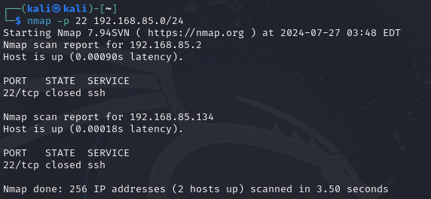
Scanning a specific Port: nmap –p <port number> Network/PREFIX
To search for a specific port, we can simply issue a command similar to the one following: example, ssh
Searching for a specific port can be quick, and in addition to that, we can scan multiple ports, all we need to do is separate them with a comma as it will show in the next slide.

Slide 12
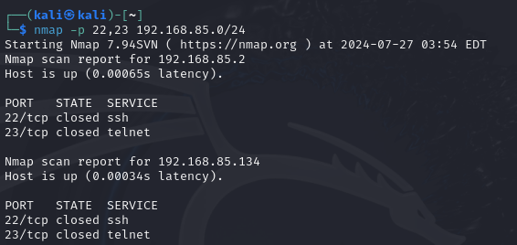
Scanning Multiple Ports at the same time:
It is similar to the scanning one port alone, and it should resemble a code appearing in the diagram on the left.
It is a straight forward and can help if we are scanning to know if a certain vulnerability exists due to opened port such as ssh or telnet

Slide 13
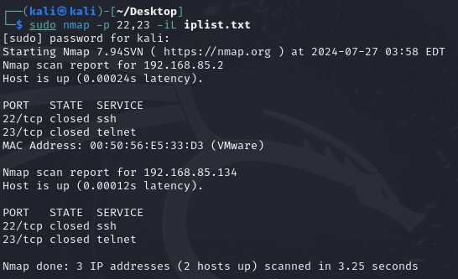
Scanning using IP List
To include the option of scanning through an IP list, we can use – iL as it will appear in the picture to the right.
We simply created a list composed of three IP addresses 2 valid and 1 invalid to scan. As you can see, it will tell you 3 IP address scanned, 2 hosts up
The command used:
Sudo nmap –p 22,23 –iL iplist.txt

Slide 14
Importance of IP list in nmap scanning
After issuing the initial scan, you will get a list of hosts that are up and running, It is wise to make a text file containing all the IP addresses you want to scan further and not waste time on hosts that are down. The benefit here resides in that wider scan can trigger firewalls and alerts,
IP addresses list can keep a low-profile while scanning the network.
In addition to saving time and keeping a low profile, IP list can speed up the process of scanning and help in make better conclusions.

Slide 15
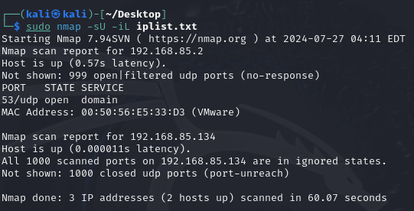
Scanning UDP Ports: sudo nmap –sU NETWORK/PREFIX
To scan UDP ports on a network, we can issue the following command:
We are using the iplist.txt to check for UDP ports, and as you can see, it works just fine with no issue.

Slide 16
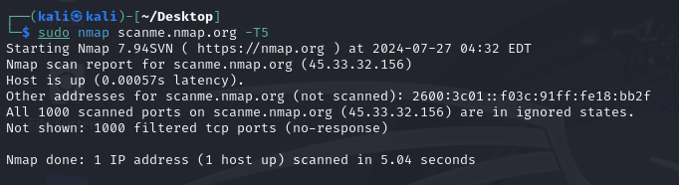
Controlling the Scanning Speed: sudo nmap –T(0-5) host
The option –T gives you the ability to choose between 0 and 5, where 0 is the slowest scanning, whereas 5 is the highest. The slower the scanning, the off of the radar you are, the fastest, the more likely you will get caught. Meaning, When you run the slowest scanning, it should be always against a specific host, not an entire network because of the awaiting time.
Please view the example below:

Slide 17
Some tips about option –T in nmap:
The default value of –T is 3, which means if you run nmap without specifying –T, it uses the default value of 3
-T5 is the fastest scan and it can be inaccurate at times because it is using speed to scan everything and return the results quickly.
-T0 is the slowest scan and it can take forever, and this is why it should always be run on a specific host, not an entire network.
The rule here is that the faster you scan, the less accurate your results will be, and the slower you scan, the more likely to get accurate scan is high. But the slower scan can take a lot of time, that is why it is advised to scan a specific host for more details, this way, you are performing in a way that cannot be detected by IDS/IPS, Intrusion Detection System or Intrusion Prevention System

Slide 18
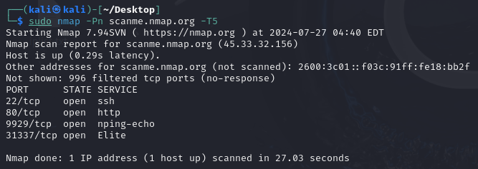
Another Example of using –T5
Below is another scan using nmap –Pn scanme.nmap.org –T5:

Slide 19
Brief Summary of some commands
Command Line | Target layer | Description
nmap <network/prefix> | General Scan | This is a general scan and usually, it takes a long time to give back results.
nmap -PR –sn <network/prefix> | This is a scan at Layer 2 | Sends broadcast message, if msg returns back, means the host is up
nmap -PE –sn <network/prefix> | This is a scan at Layer 3 | Sends ICMP message, if a reply comes back, the host is up
nmap -PA80 –sn URL | This is a scan at Layer 4 | Sends acknowledgment message. If response comes back, host is up
nmap –p <port> <network/prefix> | Scanning a specific port on network hosts | -p stands for port and after, we specify the port we want to scan.
nmap –p- <host address> | Scanning all 65,535 ports on host | Never used, but it scans the entire ports on a target hosts and usually, it is never used this way.
nmap –p <p1>,<p2> <network/prefix> | Scanning multiple ports | We can scan multiple ports at the same time.
nmap -O <network/prefix> | Scanning Operating System by checking results and running | This is the command line used for checking the operating system running on each host on a network.
nmap –sA <network/prefix> | Scanning Distribution Version on each host | This is used to find distribution versions and then, look up vulnerabilities for each version

Slide 20
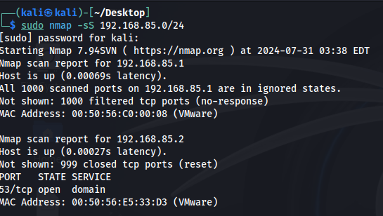
Using nmap -sS to scan:
nmap -sS scan option is one of the most useful and used syntax because: - unlike full TCP scan, it doesn’t complete the scan handshake, making itself less detectable by firewalls and intrusion detection systems. - it is also fast with comparison to other scanning types. - most commonly used nowadays for network security assessment.

Slide 21
Using the nmap -sS (SYN scan) has several advantages over other scan types:
Stealthiness:
The SYN scan does not complete the TCP handshake, making it less likely to be detected by firewalls and intrusion detection systems.
This stealthy approach helps avoid triggering alarms.
Speed:
SYN scans are generally faster than full connection scans (like -sT) because they send fewer packets and do not wait for a full handshake
to complete.
Efficiency:
It can quickly identify open ports without establishing a full connection, allowing for rapid reconnaissance of a target.
Less Impact on Target Systems:
Because it doesn't establish full connections, it puts less load on the target system, making it less disruptive.
Detailed Feedback:
The scan provides clear information about the state of ports (open, closed, or filtered) based on the responses received, helping to
assess the security posture effectively.
Compatibility with Firewalls:
Many firewalls are configured to block certain types of scans, but SYN scans can sometimes bypass these restrictions, revealing more
about the network configuration.
Flexibility:
You can easily combine the SYN scan with other Nmap options (like service version detection with -sV) for a more comprehensive assessment.
Comparison with Other Scans
TCP Connect Scan (-sT): Completes the handshake, making it more detectable and potentially more intrusive.
UDP Scan (-sU): Generally slower and more complex due to the nature of UDP, which does not establish connections.
FIN, Xmas, and Null Scans: These are also stealthy but may not work as effectively against all firewalls and can be less reliable in terms of results.
Overall, the SYN scan strikes a balance between stealth, speed, and effectiveness, making it a popular choice for network scanning.

Slide 22
Another example we did not cover is -pn option:
sudo nmap -Pn <network/prefix>: This option tells Nmap to skip the host discovery phase. It treats the target as online, which is useful if you suspect that the target may not respond to ping requests or if you want to scan a host that is configured to drop ICMP packets. For Example: nmap -Pn -sn 103.105.196.45 -p 80
-sn: This option stands for "ping scan." It tells Nmap to only check if the host is up, without performing a port scan. It will not scan any ports unless specified with -p.

